Slide 1
Step presentation
Group B
FRAUD DETECTION

Slide 2
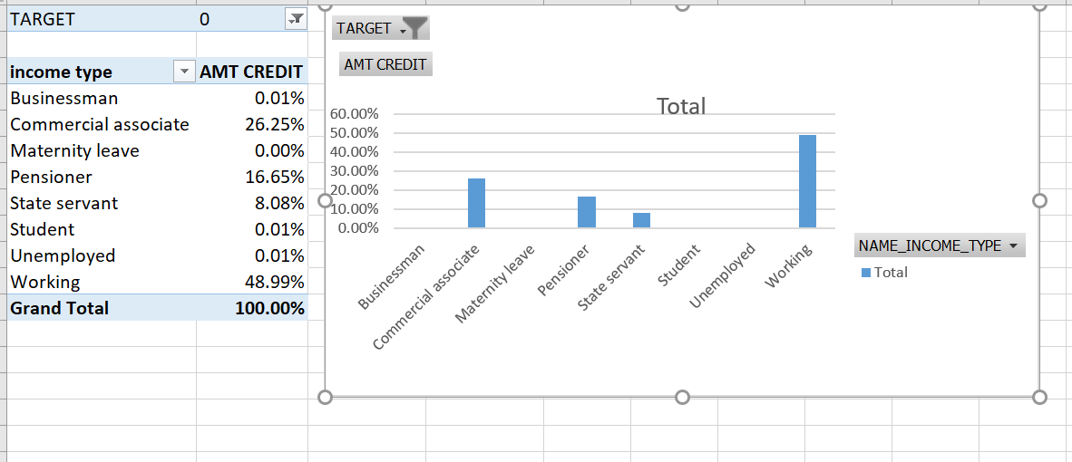
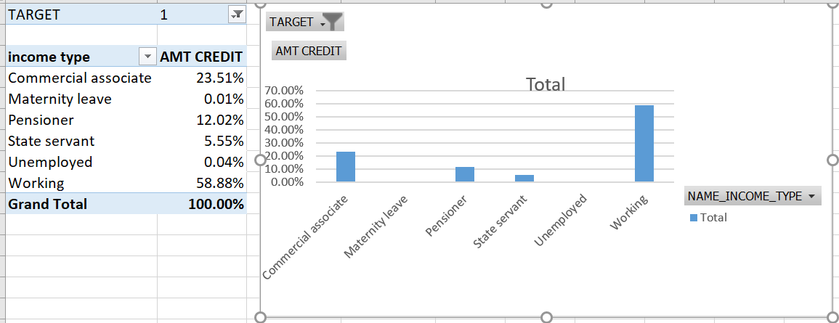
It seems that people with highest amount credited are committing more fraud

Slide 3
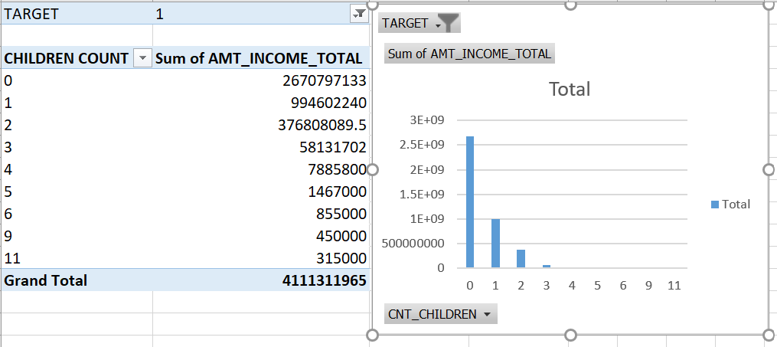
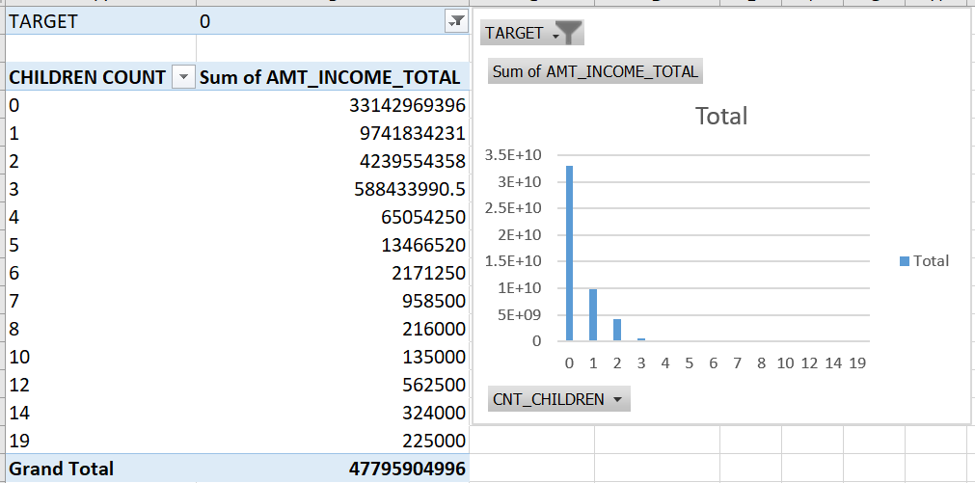
Comparatively people with less number of children with high income are accomplishing with fraud activities

Slide 4
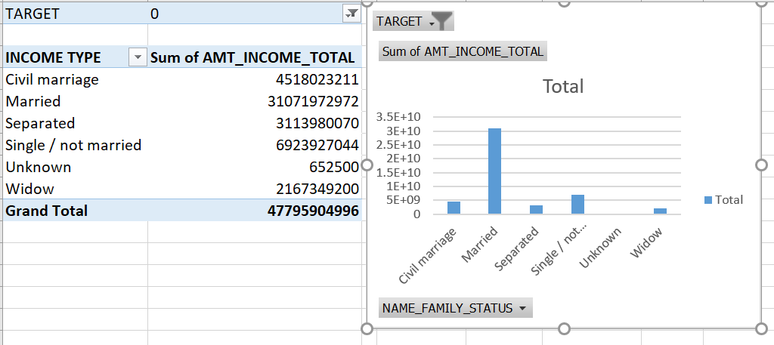
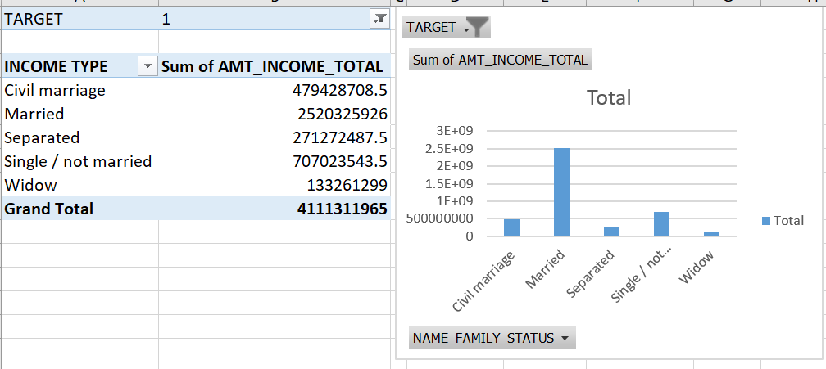
Married people with comparatively high income are seems to do fraud activities

